Slide 1
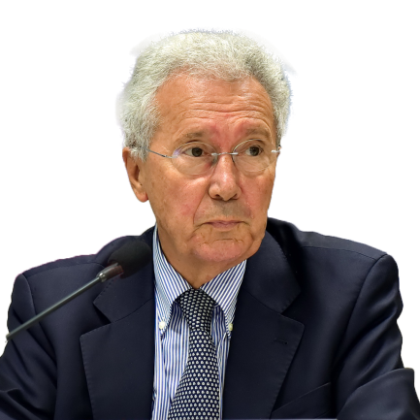
Supplementary Protection Certificates
Patentability of pharmaceutical inventions
European Patent Academy ● IGO_IFJ (Belgian Judicial Training Institute)
Brussels ● 16 January 2020
Pierre Véron
Honorary President EPLAW (European Patent Lawyers Association)
Member of the Expert Panel group of the Unified Patent Court
Member of the Drafting Committee of the Rules of Procedure

Slide 2
Contents
Why a supplementary protection for pharmaceutical products?
EU Regulation on SPCs for medicinal products, plant protection products and paediatric extension of SPC
Formal conditions for obtaining an SPC
Substantive conditions for obtaining an SPC
Scope of the SPC
Duration of the SPC
the product is protected by a basic patent in force;
a valid authorisation to place the product on the market as a medicinal product has been granted;
the product has not already been the subject of a certificate;
the authorisation referred to in point (b) is the first auth­orisation to place the product on the market as a medicinal product

Slide 3
Overview
Supplementary Protection Certificate
SPCs are a unique (sui generis) intellectual property right that constitute an extension (of up to 5 years) to the term of a patent right (of 20 years)
SPCs apply to innovative pharmaceutical and plant protection products that have been protected by a patent and authorized by regulatory authorities
They aim to offset the loss of effective patent protection that occurs due to the compulsory and lengthy testing and clinical trials that such products require prior to obtaining regulatory marketing approval

Slide 4
1. Why a supplementary protection for pharmaceutical products?
Supplementary Protection Certificates were introduced in Europe to encourage innovation by compensating for the long time needed to obtain regulatory approvals (marketing authorization) for medicaments
Available in the US and Japan as
“Patent Term Extension”

Slide 5
Patent life: the law
*
Patent protection lasts 20 years
* more precisely: 01/01/2020 00:00:00

Slide 6
Patent life: the economics mechanics, telecom, etc.

Slide 7
Patent life: the economics pharma without SPC

Slide 8
Patent life: the economics pharma with SPC

Slide 9
Patent life: the economics pharma with SPC
+ Paediatric Extension of the SPC

Slide 10
Paramount $ importance of SPC
80% of the sales of the anti-depressor Prozac
in the UK have been made after the patent expiry

Slide 11
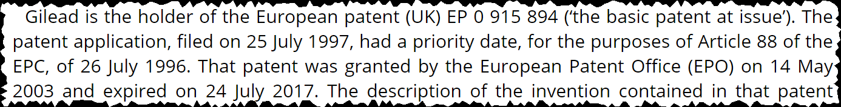
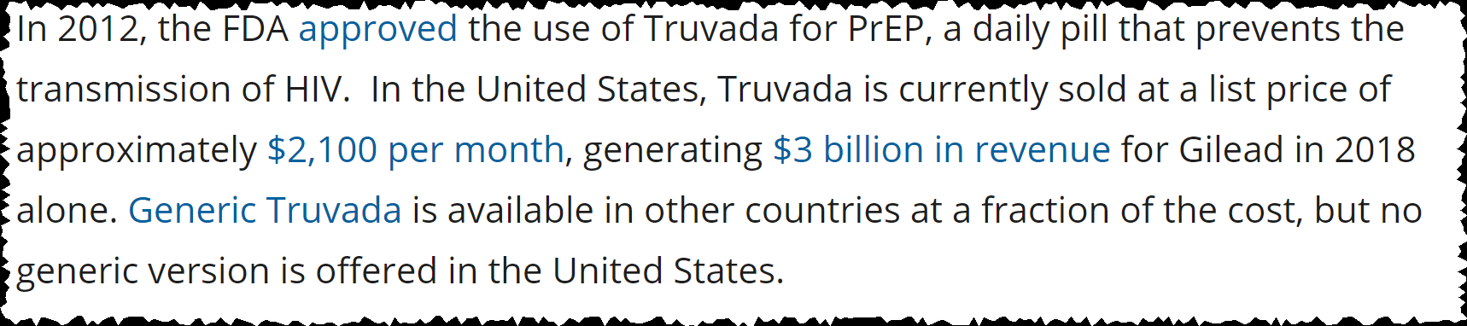
Paramount $ importance of SPC
Information in connection with the judgment handed down on 25 July 2018 by the CJEU about the antiretroviral drug Truvada® (Teva v. Gilead)

Slide 12


2. EU regulations on SPCs
Regulation (EC) № 469/2009 (codifying Regulation 1768/92) is a
EU Regulation
But the SPCs are granted nationally by the national patent offices (DE SPC, FR SPC, NL SPC, UK SPC, etc.): one application for each Member State where an SPC is requested

Slide 13
The possible future creation of a
European SPC title?
12 October 2017
EU Commission launches a Public consultation on supplementary protection certificates (SPCs) and patent research exemptions
https://ec.europa.eu/info/consultations/public-consultation-supplementary-protection-certificates-spcs-and-patent-research-exemptions_en
the creation of a European SPC title
(Unitary SPC)
an update of the scope of EU patent research exemptions
the introduction of an SPC “manufacturing waiver” (manufacturing for export outside the EU)

Slide 14

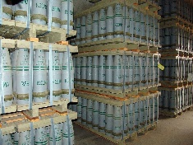
Introduction of an
SPC “manufacturing waiver”
Regulation (EU) 2019/933 of the European Parliament and of the Council of 20 May 2019 amending Regulation (EC) No 469/2009 concerning the supplementary protection certificate for medicinal products introduces
an SPC “manufacturing waiver”
(manufacturing for export outside the EU)
a “stockpiling exemption”
(manufacturing 6 months before SPC expiry
for sale in EU after SPC expiry)

Slide 15
Article 2
Regulation (EC) № 469/2009
“Any product protected by a patent in the territory of a Member State and subject, prior to being placed on the market as a medicinal product, to an administrative authorization procedure as laid down in Directive 2001/83/EC of the European Parliament and of the Council of 6 November 2001 on the Community code relating to medicinal products for human use (2) or Directive 2001/82/EC of the European Parliament and of the Council of 6 November 2001 on the Community code relating to veterinary medicinal products (3) may, under the terms and conditions provided for in this Regu­lation, be the subject of a certificate.”

Slide 16
Regulation (EEC) № 1610/96 concerning SPC for plant protection products
Recital (13):
« (13) Whereas the certificate confers the same rights as those conferred by the basic patent; whereas, consequently, where the basic patent covers an active substance and its various derivatives (salts and esters), the certificate confers the same protection; »
Recital (17):
« (17) Whereas the detailed rules in recitals (…), 13 (…) of this Regulation are also valid, mutatis mutandis, for the interpretation in particular of (…) Article 4 (…) of Council Regulation (EEC) № 1768/92. »

Slide 17
Paediatric extension of SPCs
The duration of the SPC can, however, be extended to 5 years plus 6 months when the SPC relates to a human medicinal product for which data from clinical trials conducted in accordance with an agreed Paediatric Investigation Plan (PIP) have been submitted
(Article 36 of Regulation (EC) № 1901/2006).

Slide 18

SPC prerequisites
A patent
A drug
with a marketing authorization
SPC

Slide 19

SPC legal framework
Patent
Law
SPC
Regulatory
Law

Slide 20
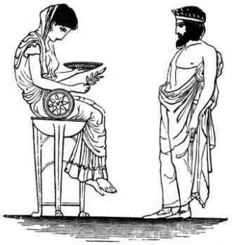
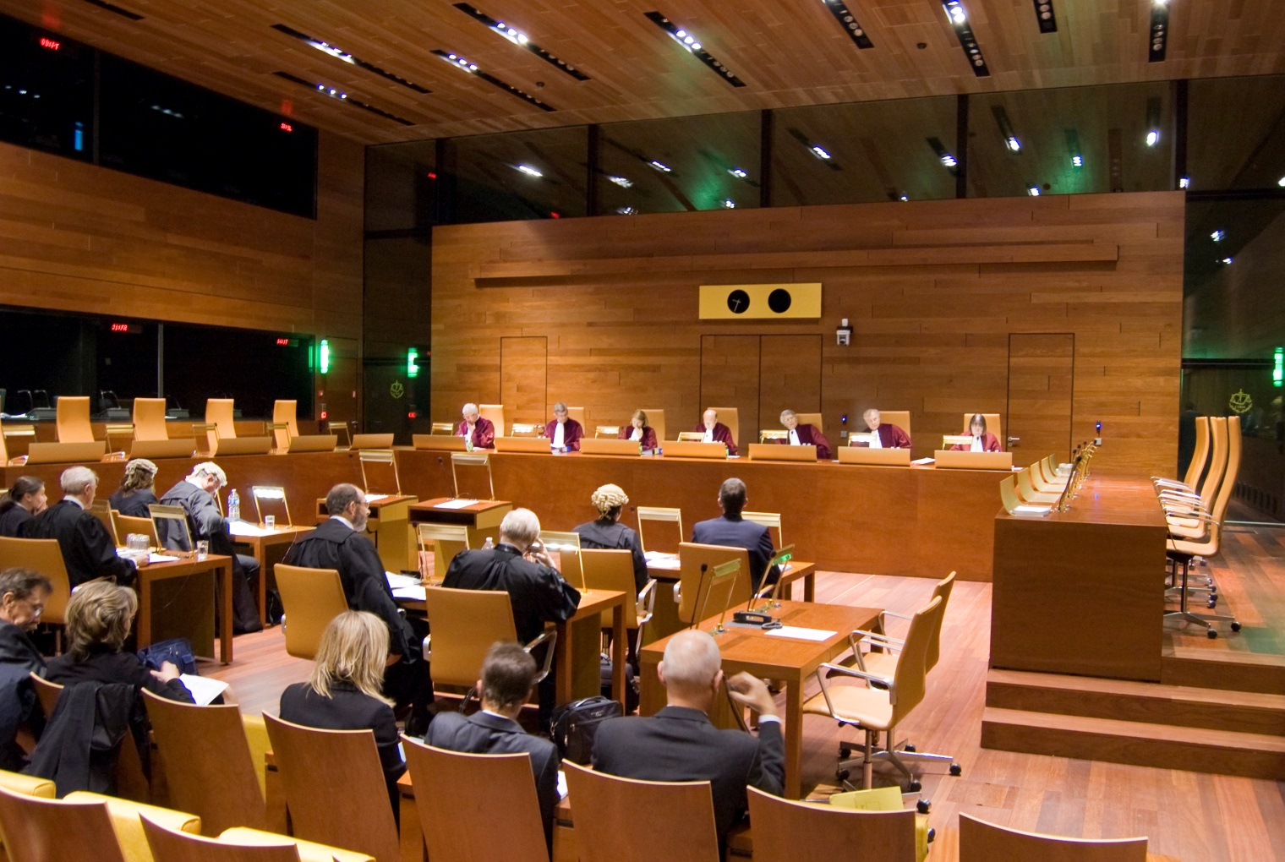

SPC: a complex legal area
41 decisions of the Court of Justice of the European Union since 1992
(21 referrals from UK courts)
+ 7 cases pending

Slide 21
3. Formal conditions for obtaining an SPC
Who can file?
When to file?
Where to file?

Slide 22
Who can file the SPC?
Article 6 Entitlement to the certificate
“The certificate shall be granted to the holder of the basic patent or his successor in title”.
Patent holder vs. Marketing Authorization holder?
When the basic patent and the Marketing Authorization are held by different entities, the patent proprietor may apply without the consent of the Marketing Authorization holder
CJEU, Case C-181/95, 23/01/97, Biogen / Smithkline]
22

Slide 23
When the SPC application should be filed?
Article 7 Application for a certificate
“The application for a certificate shall be lodged within six months of the date on which the authorization referred to in Article 3(b) to place the product on the market as a medicinal product was granted”.

Slide 24
When the SPC application should be filed?
The Liechtenstein case
“In so far as an authorisation to place a medicinal product on the market issued by the Swiss authorities and automatically recognised by the Principality of Liechtenstein under that State’s legislation is the first authorisation to place that product on the market in one of the States of the European Economic Area, it constitutes the first authorisation to place the product on the market within the meaning of Article 13 of Council Regulation (EEC) № 1768/92 of 18 June 1992 concerning the creation of a supplementary protection certificate for medicinal products, as it is to be read for the purposes of the application of the Agreement on the European Economic Area”
  CJEU, Case C-181/95, 21/04/2005, Novartis C-207/03 and C-252/03

Slide 25
Where the SPC application should be filed?
One application for each Member State where an SPC is requested; the SPC applications must be filed in the respective national patent offices:
  Deutsches Patent- und Markenamt for DE SPC
  United Kingdom Intellectual Property Office for UK SPC
  Institut National de la propriété industrielle for FR SPC
  Octrooicentrum Nederland for NL SPC…
No European SPC (Unitary SPC) at the moment
(work in progress; public consultation launched 12 October 2017 by EU Commission)

Slide 26
4. Substantive conditions for obtaining an SPC
Regulation (EC) № 469/2009
Article 3 Conditions for obtaining a certificate
the product is protected by a basic patent in force;
a valid authorisation to place the product on the market as a medicinal product has been granted;
the product has not already been the subject of a certificate;
the authorisation referred to in point (b) is the first auth­orisation to place the product on the market as a medicinal product.

Slide 27
Medicinal products
Drugs
Vaccines
Diagnosis products acting in vivo
(no SPC for product acting in vitro)
Medical device: SPC not available except when the medical device includes an active medicinal product
However a stent coated with a drug is not eligible for a SPC when the drug was not assessed as a medicinal product, but was assessed, for intended use as an accessory of the medical device
CJEU, Case C-527/17, 25/10/2018, Boston Scientific

Slide 28
The product must be “protected” by the basic patent
Article 3 a) of Regulation № 469/2009
“the product is protected by a basic patent in force within the meaning of Article 3 a)”

Slide 29
Which product can be designated in the SPC?
Article 1 b) of Regulation № 469/2009:
The active ingredient of the drug
The combination of active ingredients of the drug
More?

Slide 30
Article 3(a)
The product is “protected” in any of the forms covered by the basic patent
“where a product in the form referred to in the marketing authorization is protected by a basic patent in force, the supplementary protection certificate is capable of covering the product, as a medicinal product, in any of the forms enjoying the protection of the basic patent.
2. In order to determine, in connection with the application of Regulation № 1768/92 and, in particular, Article 3(a) thereof, whether a product is protected by a basic patent, reference must be made to the rules which govern that patent.”
CJEU, Case C‑392/97, 16/09/1999, Farmitalia Carlo Erba (Idarubicin)

Slide 31
Combination products
The “Disclosure Test” vs the “Infringement Test”
1. The “Disclosure Test”:
The combination must be disclosed or identifiable in the basic patent
(GB, FR , DE, SE)
2. The “Infringement Test”
The combination must infringe the patent pursuant to Article 69 EPC
(CH, NO, CZ)

Slide 32
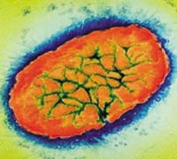
Combination products
Medeva C-322/10
Basic patent
Method claim for the preparation of an acellular B. pertussis vaccine
Marketing Authorization
Multi-vaccine against:
Whooping cough
Diphtheria
Tetanus
Polio
Meningitis

Slide 33
Combination products
The Medeva test
“1. the competent industrial property office of a Member State (may not grant) a supplementary protection certificate relating to active ingredients which are not specified in the wording of the claims of the basic patent relied on in support of the application for such a certificate.
2. the competent industrial property office of a Member State (may grant) a supplementary protection certificate for a combination of two active ingredients, corresponding to that specified in the wording of the claims of the basic patent relied on, where the medicinal product for which the marketing authorization is submitted in support of the application for a supplementary protection certificate contains not only that combination of the two active ingredients but also other active ingredients.”
CJEU, Case C-322/10, 24/11/2011, Medeva

Slide 34
1/3
Tenofovir (Gilead’s drug Truvada®)
Preliminary injunction denied in DK and FR because the SPC's combination of tenofovir disoproxil (as fumarate) and emtricitabine was not “protected by the basic patent”,
SPC held valid in CH: the Swiss court refused to adopt the CJEU's “Medeva” line of decisions. As a consequence, Swiss SPCs will be assessed based on the infringement test. No additional criteria, such as “specified in the wording of the claims” (Medeva), “the claims relate, implicitly but necessarily …” (Eli Lilly), “core inventive advance …” (Actavis) or the like are to be applied.
CJEU, Case C-121/17, 25/07/2018, Teva v. Gilead

Slide 35
2/3
Tenofovir (Gilead’s drug Truvada®)
“a product composed of several active ingredients with a combined effect is ‘protected by a basic patent in force’ within the meaning of Article 3(a) of Regulation No 469/2009 where, even if the combination of active ingredients of which that product is composed is not expressly mentioned in the claims of the basic patent, those claims relate necessarily and specifically to that combination…”
CJEU Grand Chamber, Case C-121/17, 25/07/2018, Teva v. Gilead

Slide 36
3/3
Tenofovir (Gilead’s drug Truvada®)
“For that purpose, from the point of view of a person skilled in the art and on the basis of the prior art at the filing date or priority date of the basic patent:
– the combination of those active ingredients must necessarily, in the light of the description and drawings of that patent, fall under the invention covered by that patent, and
– each of those active ingredients must be specifically identifiable, in the light of all the information disclosed by that patent.”
CJEU Grand Chamber, Case C-121/17, 25/07/2018, Teva v. Gilead

Slide 37
Regulation (EC) № 469/2009 Article 3
Further conditions for obtaining a certificate
the product is protected by a basic patent in force;
a valid authorisation to place the product on the market as a medicinal product has been granted;
the product has not already been the subject of a certificate;
the authorisation referred to in point (b) is the first auth­orization to place the product on the market as a medicinal product*.
* CJEU, Case C-443/17, 21/03/2019, Abraxis

Slide 38

5. Scope of the SPC

Slide 39
Scope of protection
Is the scope of an SPC designating the active ingredient A:
limited to the drugs having A as active ingredient?
or comparable to the scope of a patent claiming A?

Slide 40
Scope of protection
Regulation № 469/2009
Article 4, « Subject-matter of protection »:
« Within the limits of the protection conferred by the basic patent, the protection conferred by a certificate shall extend only to the product covered by the authorization to place the corresponding medicinal product on the market and for any use of the product as a medicinal product that has been authorized before the expiry of the certificate. »
Article 5, « Effects of the certificate »:
« Subject to the provisions of Article 4, the certificate shall confer the same rights as conferred by the basic patent and shall be subject to the same limitations and the same obligations. »

Slide 41
Scope of protection: combination products
“where a ‘product’ consisting of an active ingredient was protected by a basic patent and the holder of that patent was able to rely on the protection conferred by that patent for that ‘product’ in order to oppose the marketing of a medicinal product containing that active ingredient in combination with one or more other active ingredients,
a supplementary protection certificate granted for that ‘product’ enables its holder, after the basic patent has expired, to oppose the marketing by a third party of a medicinal product containing that product for a use of the ‘product’, as a medicinal product, which was authorized before that certificate expired.”
CJEU, case C-442/11, 09/02/2012 Novartis v Actavis UK

Slide 42
6. Duration of SPCs
Art 13 states that the duration of an SPC is:
  "... equal to the period which elapsed between
the date on which the application for a basic patent was lodged and
the date of the first authorisation to place the product on the market in the Community
reduced by a period of five years"
Notes:
42

Slide 43
Duration of SPCs
The maximum duration of the SPC is 5 years (+ 6 months if paediatric extension applies)
The SPC covers every medical use of the product authorized before its expiration

Slide 44
Duration of SPCs

Slide 45
Paediatric extension
Consequences of the 6-month SPC extension include:
the maximum term of an SPC can be up to 5 years and 6 months; and
the maximum duration of market exclusivity (patent + SPC) can be up to 15 years and 6 months.
An extension of an SPC can only be awarded if there is an SPC to extend; as an SPC only has a positive term if more than 5 years have elapsed between patent filing and marketing authorization issuance, this causes the so called “negative duration” scenario when the marketing authorization has been granted less that 5 years after the patent application date

Slide 46
“Negative duration” SPCs for a paediatric extension
“the period which elapsed between
the date on which the application for a basic patent was lodged (01/01/2000) and
the date of the first authorization to place the product on the market in the Community (01/01/2004)
reduced by a period of five years"

Slide 47
The Merck decision accepts
“negative duration” SPC
“… medicinal products can be the object of the grant of a supplementary protection certificate where the period that has elapsed between the date of lodging the basic patent application and the first marketing authorization in the European Union is less than five years. In such a case, the period of the paediatric extension provided for by the latter regulation starts to run from the date determined by deducting from the patent expiry date the difference between five years and the duration of the period which elapsed between the lodging of the patent application and the grant of the first marketing authorization”
Case C‑125/10, 8 December 2011, Merck Sharp & Dohme
Notes:
47
The German Federal Patent Court has decided to refer a question for preliminary ruling on negative term SPCs to the Court of Justice of the European Union in the Sitagliptin case (Case 15 W (pat) 36/08):
"Can an SPC be granted for a medicament if the period between the filing of the application for the basic patent and the time point of first authorization for marketing in the Community is shorter than five years?"

Slide 48
Pierre Véron
Thank you

